Slide 1



Analyze and Describe Boosting Algorithm.
Team Name : Devil_Coders
Team Members:
Chinmaya Nithin Dimmiti(Matriculation Number: 1386312)
KiranKumar Athirala(Matriculation Number: 1384194)
Sandhya Bagadi(Matriculation Number: 1392908)

Slide 2
Table of contents
Abstract
Introduction
HTM Overview
Methodology
Cases
Code
Unit Tests
Results
Conclusion
References

Slide 3
Abstract
Our objective of this project is to Analyze the boosting algorithm and describe how it works.
Identify which parameters of the HtmConfig class are used by the boosting algorithm
Execute Spatial Learning experiment and document what changes when changing boosting parameters
The various parameters of algorithm should be find and documented and their influence should be approved by writing various Unit Tests.

Slide 4
introduction
Hierarchical temporal memory (HTM) is a neuromorphic machine learning algorithm which resembles neocortex functions in the human brain. The HTM architecture comprises a spatial pooler (SP) and temporal memory (TM) with the sparsely, modular and hierarchically characteristical components.
The spatial pooler takes the input data and translates the incoming data into active columns.
In order for a column in a Spatial pooler to exist it should be a winning column i.e the overlap score should be above some threshold value while non-winning columns are inhibited from learning. Only the winner columns can update their permanence values.

Slide 5
continued
Boosting helps to change the overlap score before the inhibition occurs giving less active columns a better chance to express themselves and diminishing columns that seem overactive .
Boosting on better enables the learning of input data i.e it improves the efficiency.
In other words we can say that the columns that have low overlap score are boosted so that they can better express themselves and all the columns with higher overlap score are inhibited because they are expressing themselves too much.

Slide 6
continued
The main objective of this paper is to analyse various Boosting parameters namely Bump Up Weak Columns, Update Boost Factors, Update Duty Cycles, Update Min Duty Cycles, Max Boost and observe how they influence the Stability of the spatial pooler.

Slide 7
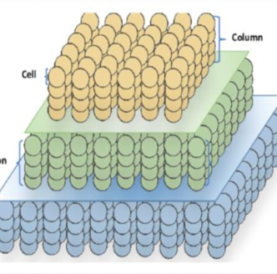
Htm overview
The HTM network is made of regions that are arranged hierarchically as shown in the figure

Slide 8
continued
Each of these regions has neurons known as cells. These cells are arranged vertically forming a column such that it responds to one single specific input at a time.
These cells can be considered as major units of HTM. These cells also have dendrites, both distant and proximal allowing them to connect with input spaces and neighbouring cells in that particular area.

Slide 9
continued
The spatial pooling operations are as follows:
Phase 0 (corresponding to initialization): Each column is randomly assigned a random set of inputs (50 percent of the input vector), which is referred to as the potential pool of the column. Each input within this pool is represented by a potential synapse and assigned a random permanence value.
Phase 1 (corresponding to overlap): The overlap for each column is computed as the number of connected synapses with active inputs multiplied by its boost. If this value is below a predefined threshold (“minOverlap”), the overlap score is set to 0.
Phase 2 (corresponding to inhibition): The number of winning columns in a local area of inhibition (neighbourhood of a column) is set to a predefined value, N. A column is a winner if its overlap score is greater than the score of the Nth highest column within its inhibition radius.
Phase 3 (corresponding to learning): During this phase, For winning columns, if a synapse is active, its permanence value is incremented; if inactive, it is decremented. There are two separate boosting mechanisms in place to help a column learn connections.

Slide 10
methodology
Boosting
The main idea behind boosting is the SDRs of symbols will use a wider range of cells by making the most active cells less active and the least active cells more active.
Boosting helps to improve the overlap score inhibition occurs, providing fewer active columns a greater chance expresses themselves and reducing hyperactive columns. Boosting on better allows for the learning of input data, which enhances efficiency.

Slide 11
continued
There are two types of boosting used in the spatial pooler algorithm:
Synaptic Boost of inactive mini columns: A mini column is defined as inactive if the number of its connected synapses at the proximal dendrite segment is not sufficient in a learning cycle. If the number of connected synapses of a mini column in the cycle to the current input is less than the stimulus threshold, then permeance values of all potential synapses of a mini column will be slightly incremented by parameter ‘stimulus increment’.
Uniform Activation of mini columns: This implement makes sure that all mini columns in the HTM area become uniformly activated. The absence of this kind of plasticity leads to very different sparsity in the HTM area, which leads to incorrect prediction and inaccurate learning. To ensure the uniform participation of mini columns in the learning, the overall column overlap, and activation are considered.

Slide 12
continued
Bump Up Weak Columns: This method ensures that each column has enough connections to input bits to allow it to become active.
Update Boost Factors: The boost factors are used to increase the overlap of active columns to improve their chances of becoming active, and hence encourage participation of more columns in the learning process
Update Duty Cycles: This is a helper function that is used to update several duty cycle variables in the column class such as overlap duty cycle, active-duty cycle, min Pct duty cycle and returns the updated duty cycle.

Slide 13
continued
Update Min Duty Cycles: It updates the minimum duty cycles for SP which uses global inhibition and sets the minimum duty cycles for the overlap and activation of all columns to be a percent of the maximum in the region, specified by Min Overlap Duty Cycles and min Pct Active-Duty Cycle respectively.
Max Boost: The Maximum overlap boost factor, each columns overlap gets multiplied by a boost factor before it considered for inhibition. The actual boost factor for a column is between 1.0 and the maxboost.
Duty Cycle: A time duration cycle which notices that which column is active for which time after inhibition. This is also called Active duty cycle which call as a function. In the code we are setting Duty_Cycle_Period to vary this parameter.

Slide 14
continued
Stimulus Increment: Synapses of weak mini columns will be stimulated by the boosting mechanism, This stimulation is done by adding this increment value to the current permanence value of the synapse.
Stimulus Threshold: This value is used by SP. When some permanence is under this value, it is set to zero. In this case the synapse remains the potential one and still can participate in learning.

Slide 15
cases
double minOctOverlapCycles | 1.0
double maxBoost | 10
int countval | 0
int inputBits | 200
int numColumns | 2048
CellsPerColumn | 10
MaxBoost | maxBoost
count | countval
DutyCyclePeriod | 50000
GlobalInhibition | true
NumActiveColumnsPerInhArea | 0.02 *numColumns
PotentialRadius | (int) (0.15 * inputBits)
LocalAreaDensity | -1
MaxSynapsesPerSegment | (int) (0.01* numColumns)
Random | new ThreadSafeRandom (42)
StimulusThreshold | 10
double max | 100
Case 1. Effect of Duty Cycle Period and max Boost (50000 & 1.0) on Spatial pattern learning.
Case 2. Effect of Duty Cycle Period and max Boost (100000 & 5.0) on Spatial pattern learning.
Case 3. Effect of Duty Cycle Period and max Boost (150000 & 10.0) on Spatial pattern learning.

Slide 16
continued
double minOctOverlapCycles | 1.0
double maxBoost | 5
int countval | 0
int inputBits | 100
int numColumns | 1024
CellsPerColumn | 10
MaxBoost | maxBoost
count | countval
DutyCyclePeriod | 10000
GlobalInhibition | true
NumActiveColumnsPerInhArea | 0.02 *numColumns
PotentialRadius | (int) (0.15 * inputBits)
LocalAreaDensity | -1
MaxSynapsesPerSegment | (int) (0.01* numColumns)
Random | new ThreadSafeRandom (42)
StimulusThreshold | 10
double max | 50
Case 4. Effect of Duty Cycle Period, max Boost and IsBumpUpWeakColumns (true) on Spatial pattern learning.
Case 5. Effect on Spatial pattern learning while Duty Cycle Period, max Boost, inputBits, numColumns, and double max are changed.
This experiment is performed by changing the values of duty cycle period, max boost, inputBits, numColumns, double max while keeping all other values constant.

Slide 17
continued
double minOctOverlapCycles | 1.0
double maxBoost | 5
int countval | 0
int inputBits | 100
int numColumns | 1024
CellsPerColumn | 10
MaxBoost | maxBoost
count | countval
DutyCyclePeriod | 10000
GlobalInhibition | true
NumActiveColumnsPerInhArea | 0.02 *numColumns
PotentialRadius | (int) (0.15 * inputBits)
LocalAreaDensity | -1
MaxSynapsesPerSegment | (int) (0.01* numColumns)
Random | new ThreadSafeRandom (42)
StimulusThreshold | 10
double max | 50
SynPermBelowStimulusInc | 0.1
SynPermTrimThreshold | 0.08
Case 6. Changed Syn Perm Below Stimulus Inc, Syn Perm Trim Threshold (0.1 & 0.08), inputBits, numColumns, double max.
This experiment is performed by changing value of Syn Perm Below Stimulus Inc, Syn Perm Trim Threshold, inputBits, numColumns, double max and keeping all other values constant

Slide 18
continued
double minOctOverlapCycles | 1.0
double maxBoost | 5
int countval | 0
int inputBits | 100
int numColumns | 1024
CellsPerColumn | 10
MaxBoost | maxBoost
count | countval
DutyCyclePeriod | 10000
GlobalInhibition | true
NumActiveColumnsPerInhArea | 0.02 *numColumns
PotentialRadius | (int) (0.15 * inputBits)
LocalAreaDensity | -1
MaxSynapsesPerSegment | (int) (0.01* numColumns)
Random | new ThreadSafeRandom (42)
StimulusThreshold | 10
double max | 50
SynPermBelowStimulusInc | 0.1
SynPermTrimThreshold | 0.08
Case 7. Changed Syn Perm Below Stimulus Inc and Syn Perm Trim Threshold (0.5 & 0.09)
This experiment is performed by changing value of Syn Perm Below Stimulus Inc and Syn Perm Trim Threshold and keeping all other values constant

Slide 19
Code
We Updated the Spatial Pattern and Spatial Pooler code to generate the CSV files of all the 4 methods used for boosting in HTMconfig.
The following methods are added in Spatial Pooler
Generate CSV for Update Boost Factors
Generate CSV for Update Duty Cycles
Generate CSV for Update Min Duty Cycles

Slide 20
Unit tests
1. BumpUpWeakColoumns.
This method increases the permanence values of synapses of columns whose overlap level is too low. Such columns are identified by having an overlap duty cycle (activation frequency) that drops too much below those of their peers. The permanence values for such columns are increased.
Description:
First by using the parameters setInputDimensions and setColumnDimensions we set the test synapses of columns. In case1 we considered SynPermBelowStimulusInc = 0.01; and SynPermTrimThreshold = 0.05;
Then the following condition is tested on a pool of test permanence values(testingpermanences):
Condition : If 'OverlapDutyCycles < MinOverlapDutyCycles' the column is considered as a weak column and hence the permanence values of synapses of columns are increased. Using this condition Expected permanences are calculated.

Slide 21
continued
2. UpdateBoostFactor
The boost factors are used to increase the overlap of active columns to improve their chances of becoming active and hence encourage participation of more columns in the learning process. This means that columns that have been active enough have a boost factor of 1, meaning their overlap is not boosted. Columns whose active-duty cycle drops too much below that of their neighbours are boosted depending on how infrequently they have been active. The more infrequent, the more they are boosted.
Formula : ' boost =(1-maxBoost)/minDuty*activeDutyCycle + maxBoost '

Slide 22
continued
3. CalcEventFrequency.
Calculates the normalised counter value of the frequency of an event. Event can be overlap or the activation of the column. Updates a duty cycle estimate with a new value. This is a helper function that is used to update several duty cycle variables in the Column class, such as: overlapDutyCucle, activeDutyCycle, minPctDutyCycleBeforeInh, minPctDutyCycleAfterInh, etc. returns the updated duty cycle.
Formula :' dutyCycle = (period - 1)*dutyCycle + newValue / period '

Slide 23

continued
4. UpdateMinDutyCycles.
It updates the minimum duty cycles for SP that uses global inhibition and sets the minimum duty cycles for the overlap and activation of all columns to be a percent of the maximum in the region, specified by Min Overlap Duty Cycles and min Pct Active-Duty Cycle respectively.
Whenever the UpdateMinDutyCycles method is called in the SP its either Local or Global Inhibition. Through inhibition radius we get the size of the local neighborhood, Then the Maximum value the neighborhood of maxActiveDuty and maxOverlapDuty is multiplied with MinPctActiveDutyCycles and MinPctOverlapDutyCycles Respectively to be a percent of the maximum in the region.

Slide 24
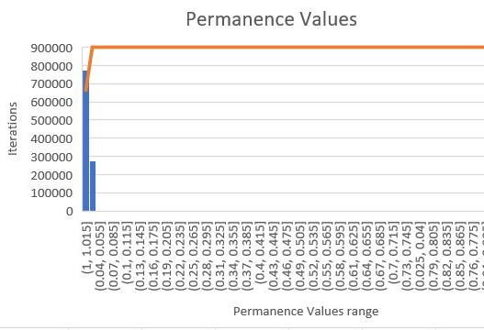
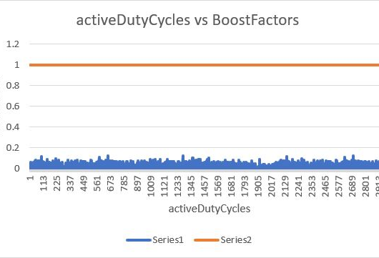
results
Case 1: In this case the boost value is kept 1.0 and duty cycle period value 50000. By changing max boost and duty cycle period the stability is attaining at cycle=0153, i=82, cols=41, s=100 and we observed that initially the SDR is not representing complete values and the program is slow. When the boosting parameter is activated the SDR is representing complete values and the total time to complete the program is 46:00 minutes.

Slide 25
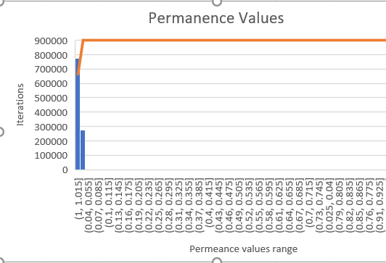
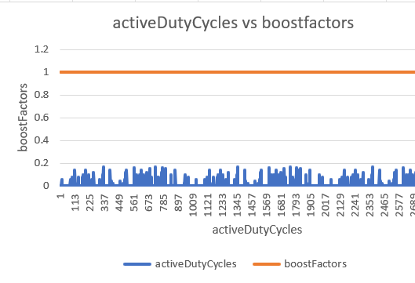
results
Case 2: In this case we increased the boost value to 5.0 and duty cycle period value 100000. By changing max boost and duty cycle period the stability is attaining at cycle=0232, i=0, cols=40, s=100 and we again observed that initially the SDR is not representing complete values and the program is slow. When the boosting parameter is activated the SDR is representing complete values and the total time to complete the program is same when compared with case1. In this case we increased both values and remaining parameters are same, so the stability also increased to cycle=0232 not 100% but approximately 90 to 95%.

Slide 26
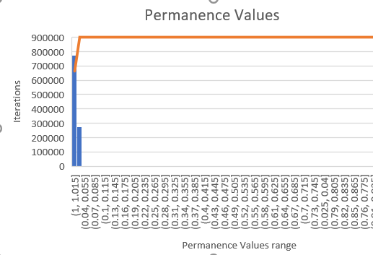
results
Case 3: In this case we increased the boost value to 10.0 and duty cycle period value 150000. By changing max boost and duty cycle period the stability is attaining at same cycle=0232, i=0, cols=40, s=100 and we again observed that initially the SDR is not representing complete values and this time the program is somewhat fast compared to case1 and case2. When the boosting parameter is activated the SDR is representing complete values and the total time to complete the program is reduced when compared with case1 and case2 (42 minutes). In this case we increased both values and remaining parameters are same, so the stability also increased to cycle=0232 not 100% but approximately 90 to 95%. We observed that with increasing the max boost and duty cycle period the stability is also increases.

Slide 27
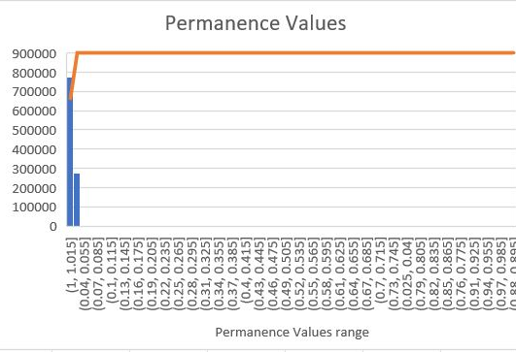
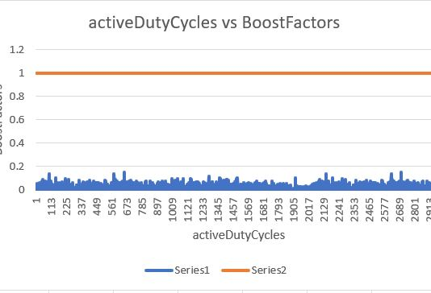
results
Case 4: In this case we decreased the boost value to 5.0 and duty cycle period value 100000 and changed one more parameter which plays a vital role for making it stable is “BUMP UP WEAK COLUMNS” to true. By changing max boost, duty cycle period and Bump Up Weak Colum to true the stability is attaining at cycle=096, i=0, cols=41, s=100 and this time we observed that it disables all the weak columns (Columns in which average or all the cells are not active). This test takes less than 30 minutes to execute all input series from 0 to 10. Initially the SDR is not representing complete values and this time the program is very fast compared to case1, case2 and case3. When the boosting parameter is activated the SDR is representing complete values and the total time to complete the program is reduced when compared with case1, case2 and case3.

Slide 28
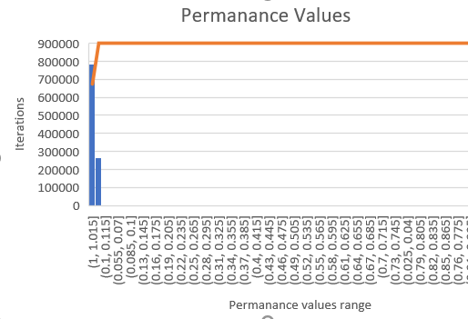
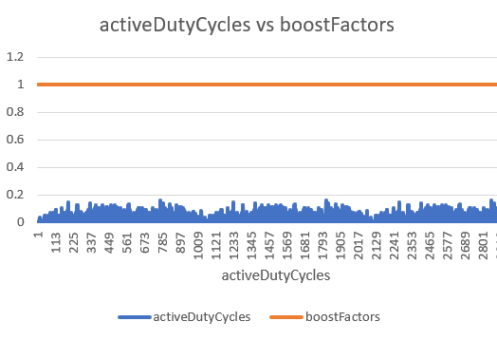
results
Case 5: In this case we kept the values same as case4 and changed the parameters input bits, num columns and double max to 100, 1024 and 50. By changing these values the system is attaining stable state at cycle=0331, i=41, cols=20, s=100. We observed that when we reduce these values the stability increases, and it reduces the execution time. The total time to execute this case is 2 minutes because of reducing num of columns and double max.

Slide 29
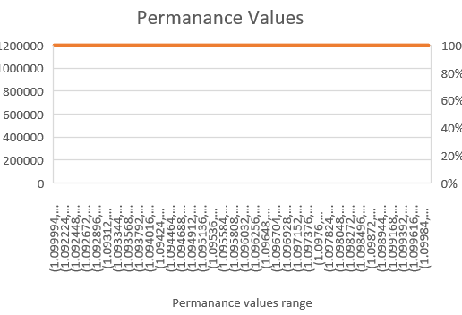
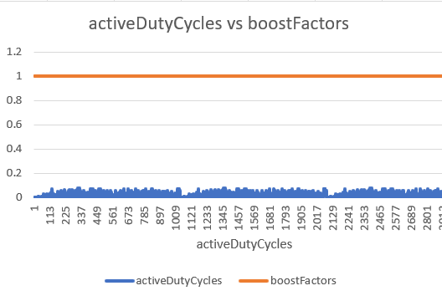
results
Case 6: In this case we changed two more parameters which comes under Bump Up Weak Columns method are Syn Perm Below Stimulus Inc and Sync perm Trim Threshold along with max boost, duty cycle period, input bits, num of columns and double max. By changing these values, we observed that the system is attaining stability at cycle=0100, i=40, cols=20, s=100. We observed that the Syn Perm Below Stimulus Inc will increment the value to the current permeance value of the synapse and Sync perm Trim Threshold value is used by SP and when some permanence is under this value, it is set on zero. The total time to complete the program is 14 minutes.

Slide 30
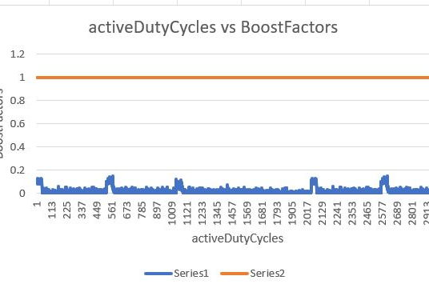
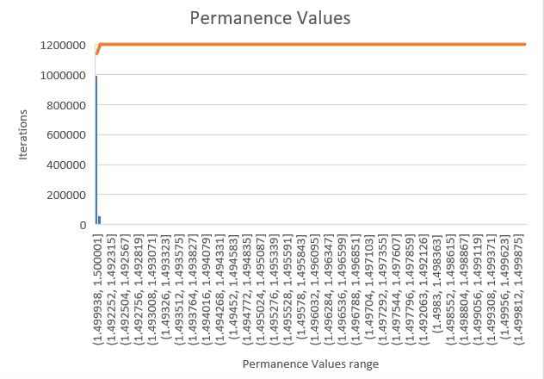
results
Case 7: In this case we changed two more parameters which comes under Bump Up Weak Columns method are Syn Perm Below Stimulus Inc and Sync perm Trim Threshold by keeping all other values constant. By changing these values, we observed that the system is attaining stability at cycle=095, i=19, cols=41, s=100. We observed that the Syn Perm Below Stimulus Inc will increment the value to the current permeance value of the synapse and Sync perm Trim Threshold value is used by SP and when some permanence is under this value, it is set on zero. This time the total time to complete the program is 46 minutes because of input bits, num of columns and double max.

Slide 31
continued
These graphical representations are the representation of data which is fetched from Spatial Pooler experiment. We ran this program many times by setting up the different values of maxBoost, Duty Cycles, Syn Perm Below Stimulus Inc, Syn Perm Trim Threshold, num of columns, input bits and double max.
By setting up the different values of maxBoost from 1 to 10 and Duty Cycles from 10000 to 150000 we concluded that there is an inverse relation of Max Boost and Duty Cycle. The higher value of boost the lower the stability is but in fact if we reduce boost but increasing Duty Cycle while the remaining parameters are same, so the stability also increase not 100% but approximately 90 to 95%. Moreover, there is one more parameter which play a vital role for making it stable is “BUMPUP”. It disables all the weak columns (Columns in which average or all the cells are not active). As this unit test takes more than 102 minutes to execute for all input series from 0 to 10 but, if we reduced no of columns from 2048 to 1024, it reduces the time of execution however, the stability still at 100%.

Slide 32
conclusion
Based on the above experiments, it can be said that various parameters of Spatial Pooler and Boosting have effects on stability. We have observed how the parameters like max Boost, Duty Cycle period, input bits (N), num of columns, double max in the Spatial Pooler effect the stability by changing the values of these parameters and comparing them with the minimum number of cycles required to get the stability. We have tested these parameters and documented the results above.
Through these experiments we understood various methods contributing to boosting in the HTM config and wrote unit-tests on them. Also, understood how boosting will help the output SDR to utilize more of input spaces and provide more information.

Slide 33
references
S. A. a. J. H. Yuwei Cui, "Numenta," 29 November 2017. [Online]. Available: https://numenta.com/neuroscience-research/research-publications/papers/htm-spatial-pooler-neocortical-algorithm-for-online-sparse-distributed-coding/.
R.Singh,"Medium.com,"31May2018.[Online].Available: https://medium.com/@rockingrichie1994/understanding-hierarchal-temporal-memory-f6a1be38e07e.
M.A.&.R.Khanna,"DeepLearning,"[Online].Available: https://link.springer.com/chapter/10.1007/978-1-4302-5990-9_9.
P. J. Mitchell, A NOVEL FPGA IMPLEMENTATION OF HIERARCHICAL TEMPORAL MEMORY SPATIAL POOLER, 2018.
Team_Devil_coders,"Github(BoostingAlgorithm),"2022.[Online].Available: https://github.com/sandhyabagadi/neocortexapi/blob/Devil_Coders/source/MySEProject/Documentation/BoostingAlgorithm.md.
A. P. 2. B. G. 1. T. W. 1. Damir Dobric 1, "Improved HTM Spatial Pooler with Homeostatic Plasticitycontrol,"[Online].Available: https://www.academia.edu/45090289/Improved_HTM_Spatial_Pooler_with_Homeostatic_Plasticity_control.
Team_DevilCoders,"Github,"[Online].Available: https://github.com/sandhyabagadi/neocortexapi/blob/43358e4ee36cb1d8cf44bb39384ca7b2e62ad24d/source/MySEProject/SpatialPooler.cs#L566.
TeamDevilCoders,"Github,"2022.[Online].Available: https://github.com/sandhyabagadi/neocortexapi/tree/Devil_Coders/source/MySEProject/Unit-Tests.
Team_DevilCoders,"Github,"2022.[Online].Available: https://github.com/sandhyabagadi/neocortexapi/blob/Devil_Coders/source/MySEProject/Documentation/ReadMe.md.
J. &. A. S. (. awkins, "Why neurons have thousands of synapses, a theory of sequence memory in neocortex. Frontiers in neural circuits, 10.," [Online].
D. Dobric, ""Github," [Online]," [Online]. Available: https://github.com/ddobric/neocortexapi-classification..

Slide 34


